Slide 1
Feed the Hungry with foodbot
By Mike Cairns
Notes:
test

Slide 2
Resources
https://www.nrdc.org/issues/food-waste
“40% of the food in the United States is never eaten, but 1 in 8 Americans struggle to put enough food on the table.”
“> 30% of all food in some cities goes to the landfill”
“Food waste drives more emissions than the airline industry”
https://en.wikipedia.org/wiki/Food_waste
“Food waste or food loss is food that is wasted, lost or uneaten. The causes of food waste or loss are numerous and occur at the stages of producing, processing, retailing and consuming.”
https://www.theguardian.com/world/2016/feb/04/french-law-forbids-food-waste-by-supermarkets
“Food banks and other charities welcome law-making large shops donate unsold food and stop spoiling items to deter foragers”
Notes:
Cities are more equipped
1/3 of food goes to landfill

Slide 3
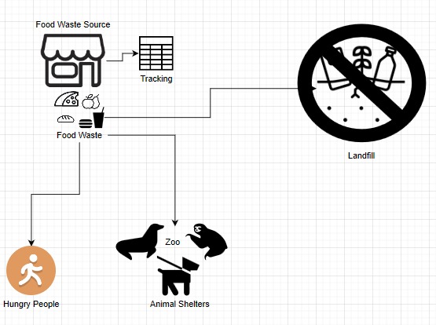
What is My Hack
Goal of my Hack
To find a way to accomplish 2 things
Reduce food waste
Feed the hungry (humans and animals)
Stock Food Banks
Animal Shelter Donations
Direct to hungry

Slide 4
What is My Hack’s impact
Education
Feed hungry kids
School Lunch Waste (Give food to kids in summer)
Healthcare
Improper Nutrition is often the precursor to many diseases
Waste food from Hospitals
Notify of free vaccinations Locations
Energy & Environment
Transporting of food has a carbon footprint. Reduce distance food must travel
Reduce methane levels by reducing food waste
St. Mary’s Food Bank
Food Banks

Slide 5
Technology Used
Avaya OneCloud CPaaS
SMS API
Google Cloud
FireBaseDB
FireBaseFunction
Docker(briefly)
Dialogflow API
Chatbot Interactions with foodbot
GitHub Repo
GitHub Desktop

Slide 6

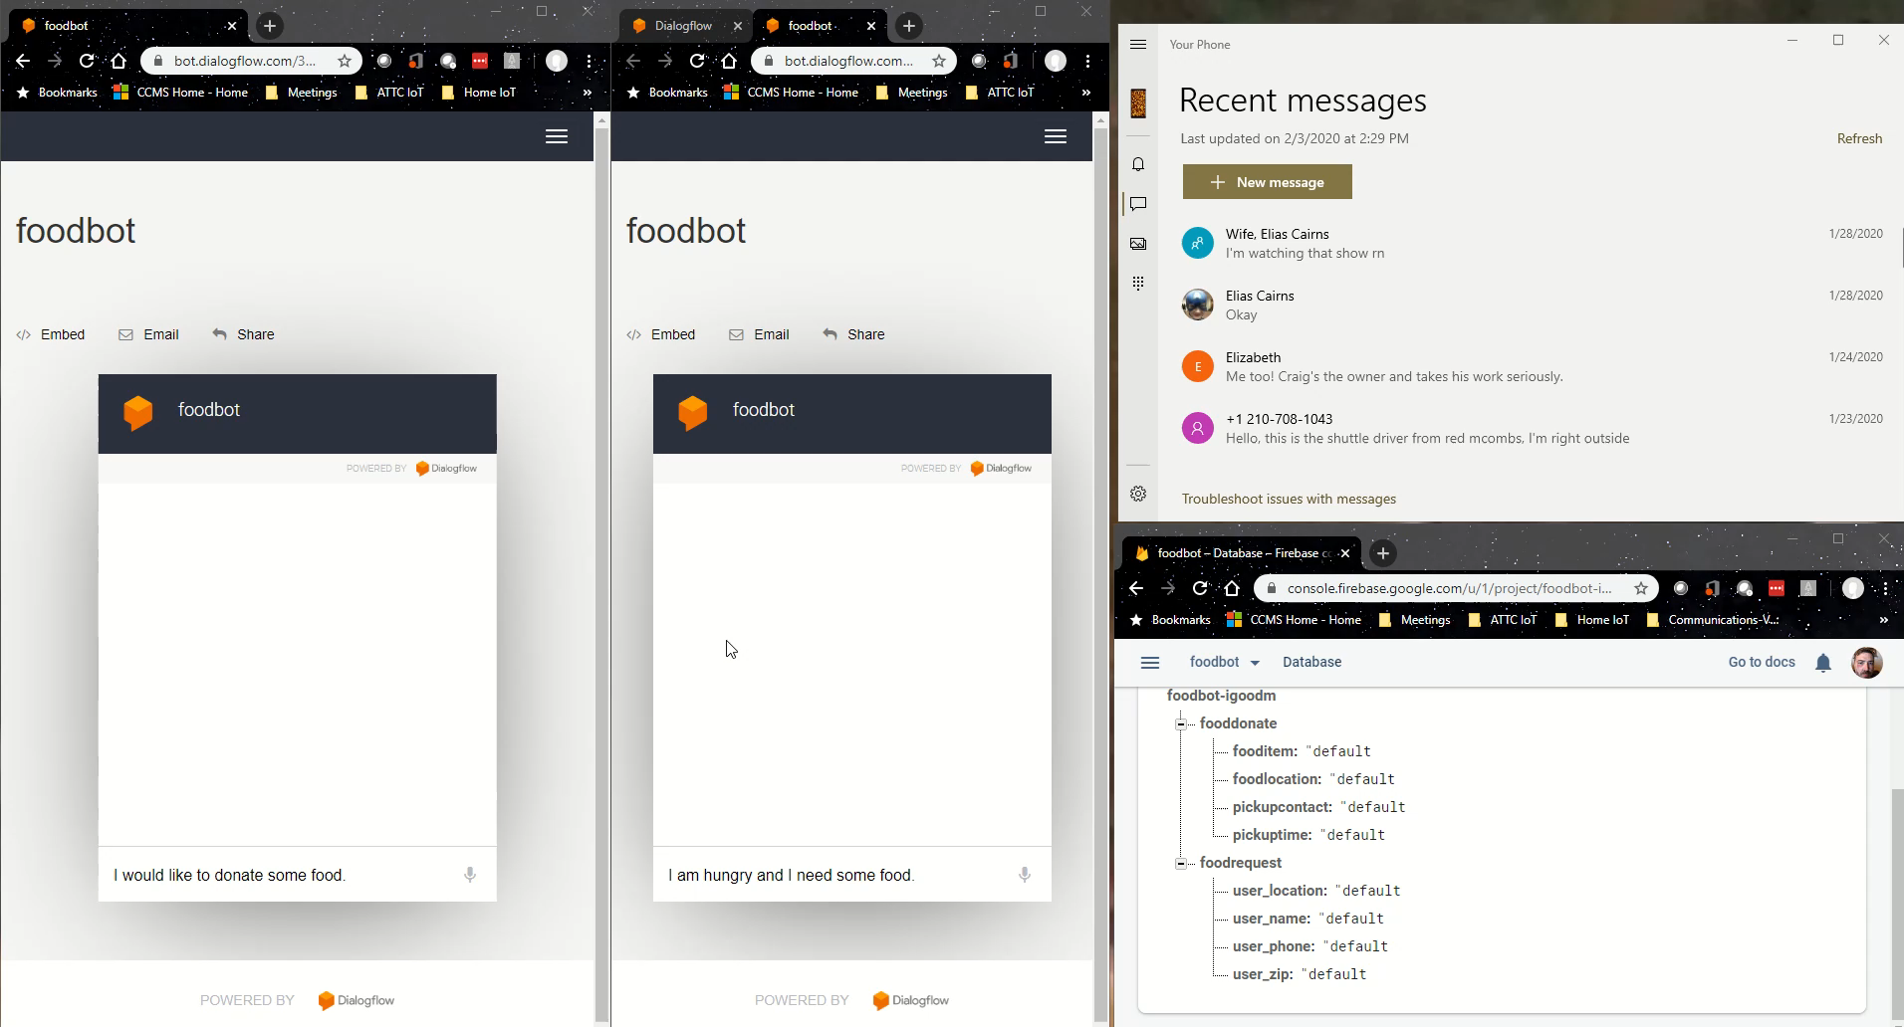
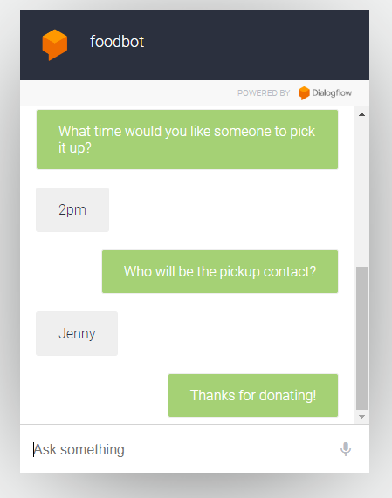
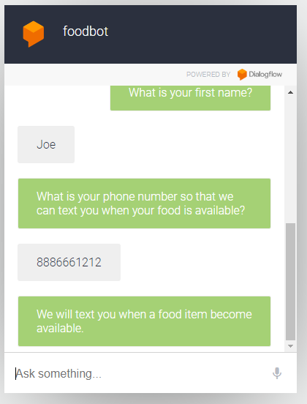

DEMO

Slide 7





Thank you Sponsors

